Slide 1
COMP3017 Service Computing

Slide 2

Module Six: Service Engineering

Slide 3
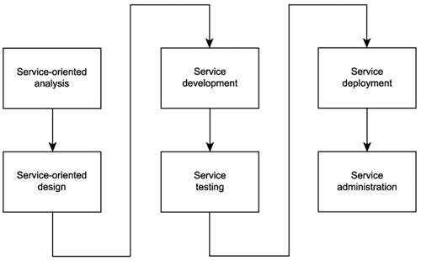
Common phases of an SOA delivery lifecycle

Slide 4
Service-oriented analysis
In this initial stage that we determine the potential scope of our SOA
Service layers are mapped out
Individual services are modeled as service candidates that comprise a preliminary SOA

Slide 5
Service-oriented design
When we know what it is we want to build, we need to determine how it should be constructed.
Service-oriented design is a heavily standards-driven phase that incorporates industry conventions and service-orientation principles into the service design process.
This phase, therefore, confronts service designers with key decisions that establish the hard logic boundaries encapsulated by services. The service layers designed during this stage can include the orchestration layer, which results in a formal business process definition.

Slide 6
Service development
The actual construction phase.
Development platform-specific issues come into play, regardless of service type.
The choice of programming language and development environment will determine the physical form services and orchestrated business processes take, in accordance with their designs.

Slide 7
Service testing (1)
Given their generic nature and potential to be reused and composed in unforeseeable situations, services are required to undergo rigorous testing prior to deployment into a production environment.

Slide 8
Service testing (2)
Some of the key issues facing service testers:
What types of service requestors could potentially access a service?
Can all service policy assertions be successfully met?
What types of exception conditions could a service be potentially subjected to?
How well do service descriptions communicate service semantics?
Do revised service descriptions alter or extend previous versions?

Slide 9
Service testing (3)
Some of the key issues facing service testers:
How easily can the services be composed?
How easily can the service descriptions be discovered?
Is compliance to WS-I profiles required?
What data typing-related issues might arise?
Have all possible service activities and service compositions been mapped out?
Have all compensation processes been fully tested?

Slide 10
Service testing (4)
Some of the key issues facing service testers:
What happens if exceptions occur within compensation processes?
Do all new services comply with existing design standards?
Do new services introduce custom SOAP headers? And, if yes, are all potential requestors (including intermediaries) required to do so, capable of understanding and processing them?
Do new services introduce functional or QoS requirements that the current architecture does not support?

Slide 11
Service deployment (1)
Installing and configuring distributed components, service interfaces, and any associated middleware products onto production servers.

Slide 12
Service deployment (2)
Typical issues that arise during this phase include:
How will services be distributed?
Is the infrastructure adequate to fulfill the processing requirements of all services?
How will the introduction of new services affect existing services and applications?
How should services used by multiple solutions be positioned and deployed?
How will the introduction of any required middleware affect the existing environment?

Slide 13
Service deployment (3)
Typical issues (cont):
Do these services introduce new versions of service descriptions that will need to be deployed alongside existing versions?
What security settings and accounts are required?
How will service pools be maintained to accommodate planned or unforeseen scalability requirements?
How will encapsulated legacy systems with performance or reliability limitations be maintained and monitored?

Slide 14
Service administration
After services are deployed, standard application management issues come to the forefront.
Issues frequently include:
How will service usage be monitored?
What form of version control will be used to manage service description documents?
How will messages be traced and managed?
How will performance bottlenecks be detected?

Slide 15
SOA Delivery Strategies

Slide 16
SOA delivery strategies
Different strategies exist for how to organize lifecycle stages to enable delivery of specialized service layers
Top-down
Bottom-up
Agile (meet-in-the-middle)

Slide 17
Top-down strategy
"analysis first" approach
Promotes the formal definition of corporate business models prior to modeling service boundaries

Slide 18
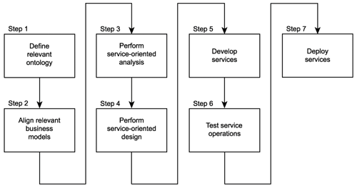

Slide 19
Top-down strategy benefits and weaknesses
It can result in highest quality level of SOA
Significant volume of up-front analysis work

Slide 20
Bottom-up strategy
This approach encourages the creation of services as a means of fulfilling application-centric requirements.
Based on the delivery of application services on an “as needed” basis
Integration is the primary motivator for bottom-up designs, where the need to take advantage of the open SOAP communications framework can be met by simply appending services as wrappers to legacy systems.

Slide 21
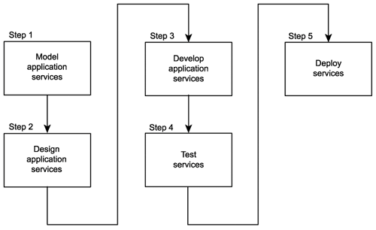

Slide 22
Bottom-up strategy benefits and weaknesses
Easy to follow
Does not result in the advancement of service-orientation

Slide 23
Agile strategy
A combination of top-down and bottom-up approaches
Business-level analysis occurs concurrently with service design and development

Slide 24
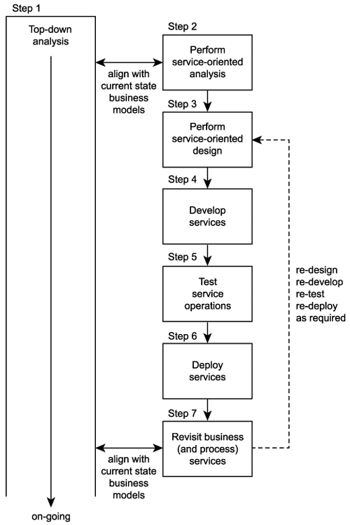

Slide 25
Agile strategy benefits and weaknesses
On-going analysis is supported, while allowing immediate delivery of service
As analysis progresses, existing services are revisited and revised as required
More complex - it needs to fulfill two opposing sets of requirements
Increased effort associated with the delivery of every service
services may need to be revisited, redesigned, redeveloped, and redeployed

Slide 26
Example: RailCo Ltd.
It started out as a brokerage for various railway wholesalers, but then came to specialize in air brakes.
– The narrowed business focus resulted in increased opportunities, as RailCo was able to become a wholesaler in its own right by dealing directly with air brake parts manufacturers.

Slide 27
RailCo's automated environment
Outdated technology
A two-tier client-server system governing all accounting and inventory control transactions.
Two administrative clerks manually feed this solution with standard transaction document data (primarily incoming and outgoing purchase orders and invoices).
Receipt and submission of these documents typically initiates
corresponding inventory receiving and order shipping processes.
A contact management system in which customer and business partner profile information is stored and maintained.
This simple application consists of a database fronted by Web- based data entry and reporting user-interfaces.
Users range from managers to administrative assistants and
accounting personnel.

Slide 28
Observed Problems
Profit margins have been noticeably declining over the past year.
Clients have been switching to a competitor providing the same products in a more efficient manner and at a lower cost.
Further investigation led to the discovery that this competitor has implemented an extension to their existing accounting system, allowing them to perform various transactions online via B2B solutions provided by some of the larger clients.
A further unpleasant revelation was that RailCo's primary client, Transit Line Systems, has started an online relationship with this competitor as well.
RailCo is a company with outdated technology automating
inefficient business processes.
Need to better respond to new business trends and automation requirements.

Slide 29
RailCo problems
RailCo's original goals
upgrade its automation systems
remain competitive
continue its business relationship with its primary client, TLS.
RailCo had lost TLS as a customer when a competitor managed to provide air brake parts at a lower price while also interfacing with TLS's B2B system.

Slide 30
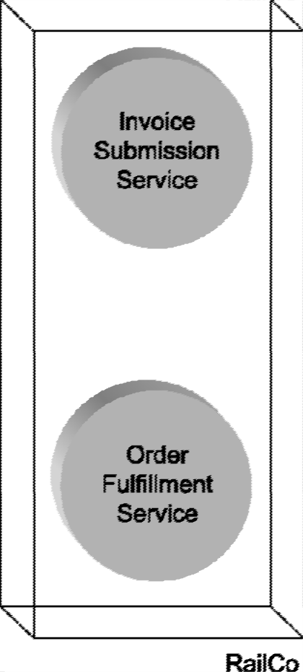
To remain competitive and minimize losses, RailCo must upgrade its automation environment as soon as possible. Its top priority is to participate in online transactions with TLS. Before our storyline begins, RailCo has already hurried to build a pair of Web services
Figure 2.1: RailCo’s initial set of Web services, designed only to allow RailCo to connect to TLS’s B2B solution.
RailCo-to-TLS Invoice Submission and the TLS-to-RailCo Purchase Order Submission Processes

Slide 31
Railco – initial services
RailCo rushed to catch up, producing a pair of Web services designed only for use with the TLS system.
This allowed RailCo to regain its position as a TLS vendor.
These two initial Web services were
Invoice Submission Service
Order Fulfillment Service
(Another service was added later to interact with the TLS Notification Service.)
RailCo’s initial set of Web services, designed only to allow RailCo to connect to TLS’s B2B solution.

Slide 32
RailCo case example - summary
RailCo realised that it was loosing their clients to their competitor
To prevent loosing their primary client, Transit Line Systems (TLS), they decided to build a pair of Web Services to participate in online transactions with TLS
RailCo-to-TLS Invoice Submission Process
TLS-to-RailCo Purchase Order Submission Process
Figure 2.1: RailCo’s initial set of Web services, designed only to allow RailCo to connect to TLS’s B2B solution.

Slide 33

Poll
1 answer(s) at most
Based on the information given in the case, RailCo constructed their services based on which approach?
A
Bottom-up
B
Top-down
C
Agile
Submit

Slide 34
Multiple Choice(single)
Points: 1
Based on the information given in the case, RailCo constructed their services based on which approach?
A
Bottom-up
B
Top-down
C
Agile
Submit

Slide 35
RailCo bottom-up Web services construction results
The services were assembled quickly, to accommodate a single client

Slide 36
RailCo bottom-up Web services construction results
The services were assembled quickly, to accommodate a single client
The services were delivered to accommodate a specific need
fulfilled immediate business requirements

Slide 37
RailCo bottom-up Web services construction results
The services were assembled quickly, to accommodate a single client
The services were delivered to accommodate a specific need
fulfilled immediate business requirements
Efficient

Slide 38
RailCo bottom-up Web services construction results
The services were assembled quickly, to accommodate a single client
The services were delivered to accommodate a specific need
fulfilled immediate business requirements
Efficient
Cost-effective

Slide 39
RailCo bottom-up Web services construction results
The services were assembled quickly, to accommodate a single client
The services were delivered to accommodate a specific need
fulfilled immediate business requirements
Efficient
Cost-effective
Initially considered successful

Slide 40
However, very soon RailCo needed to respond to multiple changes
TSL implemented a new policy that affected some of the purchase order business logic on RailCo’s end

Slide 41
However, very soon RailCo needed to respond to multiple changes
TSL implemented a new policy that affected some of the purchase order business logic on RailCo’s end
RailCo’s own internal business process underwent a change as a result of a module upgrade within their legacy accounting system
Affected low-level data access parameters processed by the RailCo Invoice Submission Service

Slide 42
However, very soon RailCo needed to respond to multiple changes
TSL implemented a new policy that affected some of the purchase order business logic on RailCo’s end
RailCo’s own internal business process underwent a change as a result of a module upgrade within their legacy accounting system
Affected low-level data access parameters processed by the RailCo Invoice Submission Service
Other RailCo’s legacy systems that interfaced with their Web services also underwent changes

Slide 43
However, very soon RailCo needed to respond to multiple changes
TSL implemented a new policy that affected some of the purchase order business logic on RailCo’s end
RailCo’s own internal business process underwent a change as a result of a module upgrade within their legacy accounting system
Affected low-level data access parameters processed by the RailCo Invoice Submission Service
Other RailCo’s legacy systems that interfaced with their Web services also underwent changes
Numerous changes were made to existing automation processes

Slide 44
Discussion
Each of the changes in numerous systems interfacing with RailCo’s Web services affected multiple services
These services needed to be redeveloped
What challenges do you see in redeveloping the Web services constructed based on bottom-up approach?

Slide 45
Redeveloping web services challenges
A significant redevelopment effort

Slide 46
Redeveloping web services challenges
A significant redevelopment effort
There was no separation of business and application logic
Change impacted a broader part of their solution environment

Slide 47
Redeveloping web services challenges
A significant redevelopment effort
There was no separation of business and application logic
Change impacted a broader part of their solution environment
None of the services were reusable
Less chance that the new requirements could be fulfilled by existing services

Slide 48
Redeveloping web services challenges
A significant redevelopment effort
There was no separation of business and application logic
Change impacted a broader part of their solution environment
None of the services were reusable
Less chance that the new requirements could be fulfilled by existing services
With each programming modification came the overhead
Testing and development phases

Slide 49
RailCo decides to start from scratch
The agile delivery strategy is chosen
Only application and business service layers will be modeled (cannot afford to invest in the middleware required to implement an orchestration layer)

Slide 50
SOA delivery lifecycle

Slide 51
Service-oriented analysis
The service-oriented analysis phase is probably the most important part of our SOA delivery lifecycle.

Slide 52
Service-oriented analysis objectives
The primary questions addressed during this phase are:
What services need to be built?
What logic should be encapsulated by each service?

Slide 53
Service-oriented analysis goals
Define a preliminary set of service operation candidates.
Group service operation candidates into logical contexts. These contexts represent service candidates.
Define preliminary service boundaries so that they do not overlap with any existing or planned services.
Identify encapsulated logic with reuse potential.
Ensure that the context of encapsulated logic is appropriate for its intended use.
Define any known preliminary composition models.

Slide 54
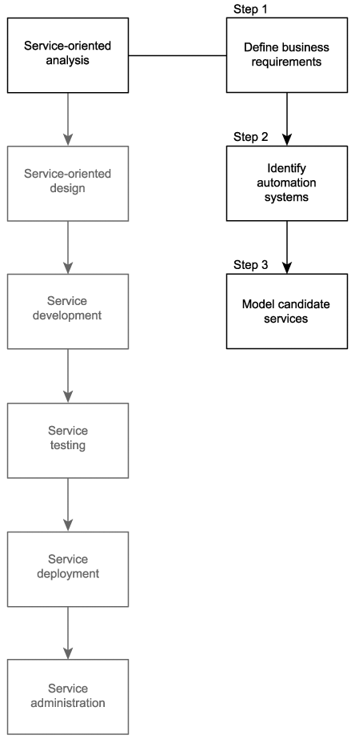

Slide 55
Step 1: Define business automation requirements
Business requirements documentation is required for this analysis process to begin
Only requirements related to the scope of a service-oriented solution should be considered
This business process documentation will be used as the starting point of the service modeling process described in Step 3.

Slide 56
Step 2: Identify existing automation systems
Gain an understanding of affected legacy environments
Existing application logic that is already automating any of the requirements identified in Step 1 needs to be identified
This information will be used to help identify application service candidates during the service modeling process described in Step 3

Slide 57
Step 3: Model candidate services
Service operation candidates are identified and then grouped into a logical context
These groups eventually take shape as service candidates
they are then further assembled into a tentative composite model representing the combined logic of the planned service-oriented application

Slide 59
Service Modelling
A service modeling process - organizing the information we gathered in Steps 1 and 2 of the service-oriented analysis process
This process can be structured in many different ways
We will provide some guidelines that can be used to customize the process to fit within organization's existing business analysis platforms and procedures

Slide 60
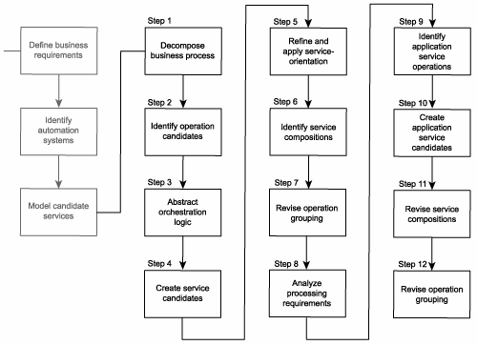
Common steps of modeling process

Slide 61
Common steps of modeling process

Slide 62
Step 1: Decompose the business process
Take the documented business process and break it down into a series of granular process steps

Slide 63
Step 1 example
We will show this step on the example of RailCo
First, let’ have a look at their business processes

Slide 64
RailCo business processes example (1)
Invoice Submission Process
Accounting clerk creates and issues an electronic invoice using the legacy accounting system.
The save event triggers a custom script that exports an electronic copy of the invoice to a network folder.
A custom developed component, which polls this folder at ten-minute intervals, picks up the document and transforms it into an XML document.
The invoice XML document is then validated. If it is deemed valid, it is forwarded to the Invoice Submission Service. If validation fails, the document is rejected, and the process ends.
Depending on when the last metadata check was performed, the service may issue a Get Metadata request to the TLS B2B solution.
If the Get Metadata request is issued and if it determines that no changes were made to the relevant TLS service descriptions, the Invoice Submission Service transmits the invoice document to the TLS B2B solution using the ExactlyOnce delivery assurance. If the Get Metadata request identifies a change to the TLS service descriptions, the invoice is not submitted, and the process ends.

Slide 65
Step 1 example
Then, we will take this business process and break it down into a series of granular process steps

Slide 66
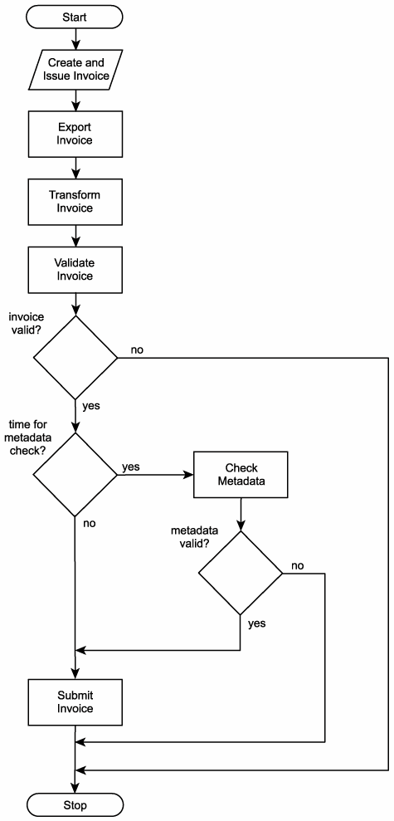
Invoice Submission Process decomposition
Create electronic invoice.
Issue electronic invoice.
Export electronic invoice to network folder.
Poll network folder.
Retrieve electronic invoice.
Transform electronic invoice to XML document.
Check validity of invoice document. If invalid, end process.
Check if it is time to verify TLS metadata.
If required, perform metadata check. If metadata check fails, end process.

Slide 67
RailCo business processes example (2)
Order Fulfilment Process
The RailCo Order Fulfilment Service receives a SOAP message from TLS, containing a payload consisting of a TLS purchase order document.
The service validates the incoming document. If valid, the document is passed to a custom component. If the TLS PO fails validation, a rejection notification message is sent to TLS, and the process ends.
The component has the XML document transformed into a purchase order that conforms to the accounting system's native document format.
The PO then is submitted to the accounting system using its import extension.
The PO ends up in the work queue of an accounting clerk who then processes the document.

Slide 68
Order Fulfilment Process
The RailCo Order Fulfilment Service receives a SOAP message from TLS, containing a payload consisting of a TLS purchase order document.
The service validates the incoming document. If valid, the document is passed to a custom component. If the TLS PO fails validation, a rejection notification message is sent to TLS, and the process ends.
The component has the XML document transformed into a purchase order that conforms to the accounting system's native document format.
The PO then is submitted to the accounting system using its import extension.
The PO ends up in the work queue of an accounting clerk who then processes the document.

Slide 69
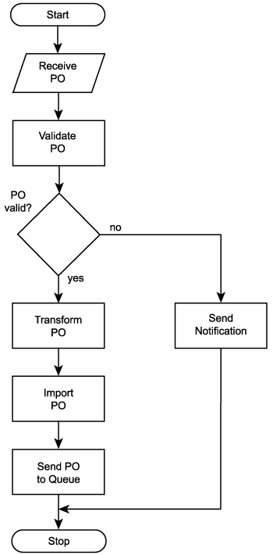
Order Fulfilment Process decomposition
Receive PO document.
Validate PO document.
If PO document is invalid, send rejection notification and end process.
Transform PO XML document into native electronic PO format.
Import electronic PO into accounting system.
Send PO to accounting clerk's work queue.

Slide 70
Step 2: Identify business service operation candidates
Some steps within a business process can be easily identified as not belonging to the potential logic that should be encapsulated by a service candidate
Manual process steps that cannot or should not be automated
Process steps performed by existing legacy logic for which service candidate encapsulation is not an option
By filtering out these parts we are left with the processing steps most relevant to our service modeling process.

Slide 71
Step 2 example
We will show this step on the example of RailCo
First, recall their decomposed business processes

Slide 72
Invoice Submission Process:
Create electronic invoice. (A manual step performed by the accounting clerk.)
Issue electronic invoice. (A manual step performed by the accounting clerk.)
Export electronic invoice to network folder. (Currently a custom developed extension of the legacy system. Could be made part of a generic service candidate.)
Poll network folder. (Currently performed by a custom developed component. Could be made part of a service candidate.)
Retrieve electronic invoice. (Same as previous.)
Transform electronic invoice to XML document. (Same as previous.)
Check validity of invoice document. If invalid, end process. (Is currently being performed as part of the Invoice Submission Service's parsing routine. No foreseeable need to change this.)
Check if it is time to verify TLS metadata. (Is currently being performed as part of the Invoice Submission Service's parsing routine. Looks like a potentially reusable operation candidate. Could be moved to a separate service candidate.)
If required, perform metadata check. If metadata check fails, end process. (Same as previous.)

Slide 73
Order Fulfillment Process
Receive PO document. (Is currently being performed by the Order Fulfillment Service. No foreseeable need to change this.)
Validate PO document. (Same as previous.)
If PO document is invalid, send rejection notification and end process. (Same as previous.)
Transform PO XML document into native electronic PO format. (Currently performed by a custom developed component. Could be made part of a service candidate.)
Import electronic PO into accounting system. (Currently a custom developed extension of the legacy system. Could be made part of a generic service candidate.)
Send PO to accounting clerk's work queue. (Same as previous.)

Slide 74
Step 2 RailCo example
The result of this review is that only two processing steps were removed from the Invoice Submission Process and none from the Order Fulfillment Process.

Slide 75
Step 3: Abstract orchestration logic
If the decision was made to not incorporate an orchestration service layer - then skip this step
If it was decided to build an orchestration layer as part of the SOA, then we should identify the parts of the processing logic that this layer would abstract
Potential types of logic suitable for this layer include:
business rules
conditional logic
exception logic
sequence logic

Slide 76
Step 4: Create business service candidates
Review the processing steps that remain after we completed step 2 and determine one or more logical contexts with which these steps can be grouped.
Each context represents a service candidate.
In this step, we can also add additional service operation candidates not required by the current business process, but added to round out entity services with a complete set of reusable operations.

Slide 77
Step 4 example
We will continue our RailCo case to illustrate this step

Slide 78
Example
First, we will review the list of steps in both processes of RailCo (without those we crossed out)

Slide 79
Invoice Submission Process:
Create electronic invoice. (A manual step performed by the accounting clerk.)
Issue electronic invoice. (A manual step performed by the accounting clerk.)
Export electronic invoice to network folder. (Currently a custom developed extension of the legacy system. Could be made part of a generic service candidate.)
Poll network folder. (Currently performed by a custom developed component. Could be made part of a service candidate.)
Retrieve electronic invoice. (Same as previous.)
Transform electronic invoice to XML document. (Same as previous.)
Check validity of invoice document. If invalid, end process. (Is currently being performed as part of the Invoice Submission Service's parsing routine. No foreseeable need to change this.)
Check if it is time to verify TLS metadata. (Is currently being performed as part of the Invoice Submission Service's parsing routine. Looks like a potentially reusable operation candidate. Could be moved to a separate service candidate.)
If required, perform metadata check. If metadata check fails, end process. (Same as previous.)

Slide 80
Order Fulfillment Process
Receive PO document. (Is currently being performed by the Order Fulfillment Service. No foreseeable need to change this.)
Validate PO document. (Same as previous.)
If PO document is invalid, send rejection notification and end process. (Same as previous.)
Transform PO XML document into native electronic PO format. (Currently performed by a custom developed component. Could be made part of a service candidate.)
Import electronic PO into accounting system. (Currently a custom developed extension of the legacy system. Could be made part of a generic service candidate.)
Send PO to accounting clerk's work queue. (Same as previous.)

Slide 81
Example
Now, we need to group them into logical contexts
What are the contexts we can group remaining services into?

Slide 82
Step 4 RailCo example
Going through the RailCo steps we listed from both processes, here is how they could be grouped:
Legacy System Service
Export electronic invoice to network folder.
Import electronic PO into accounting system.
Send PO to accounting clerk's work queue.
Invoice Processing Service
Poll network folder for invoice.
Retrieve electronic invoice.
Transform electronic invoice to XML document.
Check validity of invoice document. If invalid, end process.
PO Processing Service
Receive PO document.
Validate PO document.
If PO document is invalid, send rejection notification and end process.
Transform PO XML document into native electronic PO format.
Metadata Checking Service
Check if it is time to verify TLS metadata.
If required, perform metadata check. If metadata check fails, end process.

Slide 83
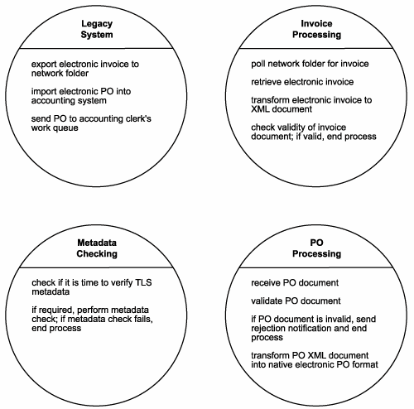
Step 4 RailCo example (2)
RailCo’s service candidates

Slide 84
Step 5: Refine and apply principles of service-orientation
So far we have just grouped processing steps derived from an existing business process
To make our service candidates truly worthy of an SOA, we must take a closer look at the underlying logic of each proposed service operation candidate
In this step we will make adjustments by applying key service-orientation principles
reusability
autonomy

Slide 85
Step 5 RailCo example (1)
We will continue our RailCo case to illustrate this step
Let us recall the initial service candidates we identified in step 4
We will review the operation candidates within our service candidates and make a series of adjustments

Slide 86
Let us analyse our current design of Legacy System Service
Legacy System Service has at the moment 3 service operation candidates
Export electronic invoice to network folder.
Import electronic PO into accounting system.
Send PO to accounting clerk's work queue.

Slide 87
Activity
Apply reusability and autonomy principles to adjust the service candidates in our initial design

Slide 88
Step 5 RailCo example – applying autonomy principle
Within the Legacy System Service, the "Send PO to accounting clerk's work queue" action can be performed only upon the receipt of a document. This operation candidate is therefore directly dependent on the "Import electronic PO into accounting system" step. We therefore decide to combine these two steps into one.
Legacy System Service has at the moment 3 service operation candidates
Export electronic invoice to network folder.
Import electronic PO into accounting system.
Send PO to accounting clerk's work queue.

Slide 89
Step 5 RailCo example – applying autonomy principle
Within the Legacy System Service, the "Send PO to accounting clerk's work queue" action can be performed only upon the receipt of a document. This operation candidate is therefore directly dependent on the "Import electronic PO into accounting system" step. We therefore decide to combine these two steps into one.
Adjustment:
A new operation candidate "Import and forward document to work queue" is a combination of:
"Send PO to accounting clerk's work queue"
"Import electronic PO into accounting system“

Slide 90
Step 5 RailCo example – applying reusability principle
This leaves us with a single operation candidate “Export electronic invoice to network folder” that we would like to make more reusable by allowing it to handle different types of documents.

Slide 91
Open Question
Points: 10
Make “Export electronic invoice to network folder” more reusable by designing it in more generic way (hint: give it a more generic name)
Suggest the name of the new operation candidate.
Open Question is only supported on Version 2.0 or newer.
Answer

Slide 92
Step 5 RailCo example – applying reusability principle
This leaves us with a single operation candidate “Export electronic invoice to network folder” that we would like to make more reusable by allowing it to handle different types of documents.
Adjustment
Make “Export electronic invoice to network folder” more reusable by designing it in more generic way
“export document to network folder”

Slide 93
Step 5 RailCo example
The revised Legacy System Service list contains the following steps:
Export document to network folder.
Import and forward document to work queue.

Slide 94
Activity
Let’s now examine Invoice Processing Service

Slide 95
Making adjustments in Invoice Processing Service
Invoice Processing Service has 4 operation candidates at the moment
Poll network folder for invoice.
Retrieve electronic invoice.
Transform electronic invoice to XML document.
Check validity of invoice document. If invalid, end process.

Slide 96
Open Question
Points: 10
Let’s now examine Invoice Processing Service
One of operation candidates is "Poll network folder for invoice“. Let’s apply the principle of reusability. How can we make this operation more reusable?
Open Question is only supported on Version 2.0 or newer.
Answer

Slide 97
Step 5 RailCo example
Upon reviewing the Invoice Processing Service, a number of refinement opportunities arise. We determine that the "Poll network folder for invoice" action can be made more generic by turning it into an operation candidate that simply polls a given folder for different types of documents.
Adjustment
"Poll network folder for invoice“ becomes “poll folder for new documents”

Slide 98
Making adjustments in Invoice Processing Service
Invoice Processing Service has 4 operation candidates at the moment
Poll network folder for invoice. -→ poll folder for new documents
Retrieve electronic invoice.
Transform electronic invoice to XML document.
Check validity of invoice document. If invalid, end process.

Slide 99
Step 5 RailCo example
We also decide that this action should be made part of a service candidate capable of notifying subscribers of the arrival of new documents.
The result of our analysis is a new context (a new service candidate), established to represent generic notification actions, as follows:
Polling Notification Service:
Poll folder for new documents.
If documents arrive for which there are subscribers, issue notifications.

Slide 100
Making adjustments in Invoice Processing Service
Invoice Processing Service has 4 operation candidates at the moment
Poll network folder for invoice. -→ poll folder for new documents
Retrieve electronic invoice.
Transform electronic invoice to XML document.
Check validity of invoice document. If invalid, end process.
Polling Notification Service:
Poll folder for new documents.
If documents arrive for which there are subscribers, issue notifications.

Slide 101
Step 5 RailCo example
Next, we decide to combine the "Retrieve electronic invoice," "Transform electronic invoice to XML document," and "Check validity of invoice document" operation candidates into a single service operation candidate called "Retrieve and transform invoice document."
We don't mention the validation aspect of this action because the XML document automatically is assigned a corresponding schema. The validation of the document is therefore an intrinsic part of the transformation process.
The revised Invoice Processing Service list is left with just one step:
Retrieve and transform invoice document.

Slide 102
Making adjustments in Invoice Processing Service
Invoice Processing Service has 4 operation candidates at the moment
Poll network folder for invoice. -→ poll folder for new documents
Retrieve electronic invoice.
Transform electronic invoice to XML document.
Check validity of invoice document. If invalid, end process.
Retrieve and transform invoice document.
Polling Notification Service:
Poll folder for new documents.
If documents arrive for which there are subscribers, issue notifications.

Slide 103
Adjusting PO Processing Service
PO Processing Service
Receive PO document.
Validate PO document.
If PO document is invalid, send rejection notification and end process.
Transform PO XML document into native electronic PO format.

Slide 104
Step 5 RailCo example
Next, we tackle the operation candidates in the PO processing group. Though listed as such, the "Receive PO document" is not a suitable service operation candidate, as receiving a message is a natural part of service operations (and therefore not generally explicitly accounted for).
Adjustment
Remove "Receive PO document" from our list.

Slide 105
Adjusting PO Processing Service
PO Processing Service
Receive PO document.
Validate PO document.
If PO document is invalid, send rejection notification and end process.
Transform PO XML document into native electronic PO format.

Slide 106
Step 5 RailCo example (9)
We then detect a direct dependency between the "If PO document is invalid, send rejection notification and end process" and "Validate PO document" actions.
Adjustments
As a result we decide to combine these into a single operation candidate called "Validate PO document and send rejection notification, if required.“

Slide 107
Adjusting PO Processing Service
PO Processing Service
Receive PO document.
Validate PO document.
If PO document is invalid, send rejection notification and end process.
Validate PO document and send rejection notification, if required
Transform PO XML document into native electronic PO format.

Slide 108
Multiple Choice(single)
Points: 1
In our previous exercise, we have detected a direct dependency between the two operation candidates and combined them into one candidate. Which service design principle have we applied?
A
Autonomy
B
Reusability
C
Discoverability
Submit

Slide 109
Step 5 RailCo example
We move on to discover commonality between the "Transform PO XML document into native electronic PO format" action and the "Retrieve and transform invoice document" action from our Invoice Processing Service list.

Slide 110
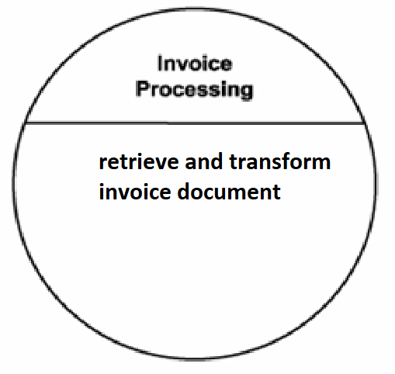
Step 5 RailCo example

Slide 111
Open Question
Points: 10
Remark
We discover that there is a commonality between the "Transform PO XML document into native electronic PO format" action and the "Retrieve and transform invoice document" action from our Invoice Processing Service list. Can you specify what these two operation candidates have in common?
Both operation candidates transform accounting documents.
Open Question is only supported on Version 2.0 or newer.
Answer
Text\Image\Formula are allowed and all the content should be placed in this area

Slide 112
Step 5 RailCo example
Both operation candidates transform accounting documents.
We therefore decide to create a new service candidate that provides generic transformation.

Slide 113
Step 5 RailCo example
We move on to discover commonality between the "Transform PO XML document into native electronic PO format" action and the "Retrieve and transform invoice document" action from our Invoice Processing Service list.
Both operation candidates transform accounting documents. We therefore decide to create a new service candidate that provides generic transformation.
Adjustment – The result is a new grouping category:
Transform Accounting Documents Service:
Transform XML documents to native format.
Transform native documents to XML.

Slide 114
Adjusting PO Processing Service
Invoice Processing Service has 4 operation candidates at the moment
Retrieve and transform invoice document.
PO Processing Service
Receive PO document.
Validate PO document.
If PO document is invalid, send rejection notification and end process.
Validate PO document and send rejection notification, if required
Transform PO XML document into native electronic PO format
Transform Accounting Documents Service:
Transform XML documents to native format.
Transform native documents to XML.

Slide 115
Step 5 RailCo example (11)
The revised PO Processing Service list is left with just one step:
Validate PO document and send rejection notification, if required.

Slide 116
Step 5 RailCo example
Finally, our last group of operation candidates is reviewed. The candidates themselves are still relatively suitable for what we intended. However, because we've abstracted these into a generic service candidate, we need to revise the wording to better reflect this. Specifically, we add a notification feature to our Metadata Checking Service candidate.
The revised Metadata Checking Service list contains the following steps:
Check if it is time to verify TLS metadata. If required, perform metadata check.
If metadata check fails, issue notification.

Slide 117
We have finished making adjustments to our initial design
Let us have a look what service candidates and service operation candidates are considered in our new design

Slide 118
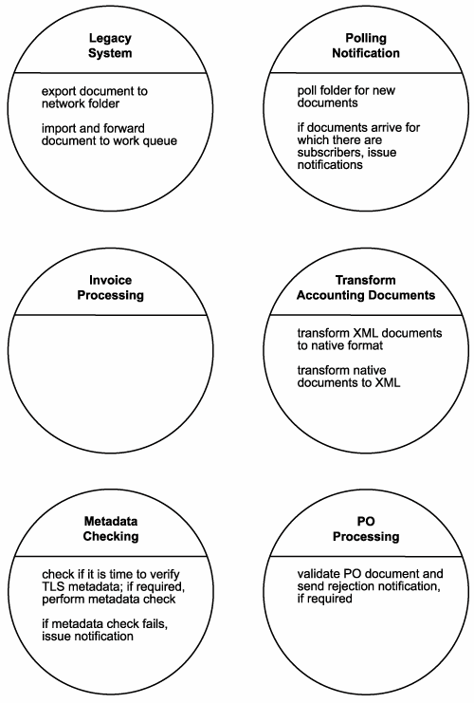
The revised design

Slide 119
Common steps of modeling process

Slide 120
Step 6: Identify candidate service compositions
Identify a set of the most common scenarios that can take place within the boundaries of the business process.
For each scenario, follow the required processing steps as they exist now.
This exercise accomplishes the following:
It gives you a good idea as to how appropriate the grouping of your process steps is.
It demonstrates the potential relationship between orchestration and business service layers.
It identifies potential service compositions.
It highlights any missing workflow logic or processing steps.
Ensure that as part of your chosen scenarios you include failure conditions that involve exception handling logic. Note also that any service layers you establish at this point are still preliminary and still subject to revisions during the design process

Slide 121
Step 6 RailCo example (1)
We will continue our RailCo case to illustrate this step

Slide 122
Step 6 RailCo example (2)
Let's recap some of the service candidates established so far.
Legacy System Service
Polling Notification Service
Transform Accounting Documents Service
Metadata Checking Service
Each of these service candidates represents generic, reusable, and business-agnostic logic. In other words, these can all be classified as application service candidates.
Collectively they establish a preliminary application service layer.

Slide 123
Step 6 RailCo example (3)
But what about our business service candidates?
PO Processing Service candidate still had one action associated with it
Invoice Processing Service operation candidates disappeared after we abstracted all of the associated process actions into separate application service candidates

Slide 124
Step 6 RailCo example (4)
The fact that we've reduced the processing requirements of these two service candidates does not mean that we don't have a need for them.
The primary role of task-centric business services is to act as controllers, composing application services to carry out the required business logic.
Both the PO Processing and Invoice Processing Service candidates establish a preliminary parent business service layer and contain all of the process logic required to compose the underlying application service candidates

Slide 125
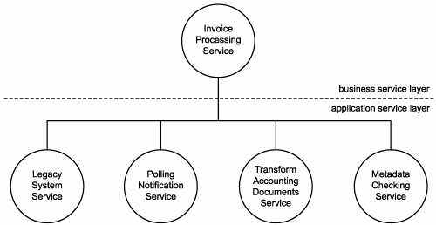
Step 6 RailCo example (5)
A sample composition representing the Invoice Submission Process.

Slide 126
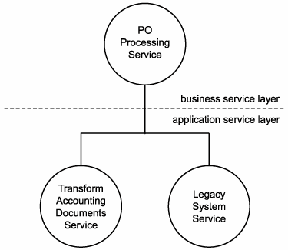
Step 6 RailCo example (6)
A sample composition representing the Order Fulfillment Process.

Slide 127
Common steps of modeling process

Slide 128
Step 7: Revise business service operation grouping
Based on the results of the composition exercise in Step 6, revisit the grouping of your business process steps and revise the organization of service operation candidates as necessary.
It is not unusual to consolidate or create new groups (service candidates) at this point.

Slide 129
Common steps of modeling process

Slide 130
Step 8: Analyze application processing requirements
Optional and more suited for complex business processes and larger service-oriented environments
Requires to more closely study the underlying processing requirements of all service candidates to abstract any further technology-centric service candidates from this view that will complete a preliminary application services layer.
To accomplish this, each processing step identified so far is required to undergo a mini-analysis.
Specifically, what needs to determined is:
What underlying application logic needs to be executed to process the action described by the operation candidate.
Whether the required application logic already exists or whether it needs to be newly developed.
Whether the required application logic spans application boundaries. In other words, is more than one system required to complete this action?

Slide 131
Common steps of modeling process

Slide 132
Step 9: Identify application service operation candidates
Break down each application logic processing requirement into a series of steps.
Be explicit about how you label these steps so that they reference the function they are performing.

Slide 133
Common steps of modeling process

Slide 134
Step 10: Create application service candidates
Group these processing steps according to a predefined context.
With application service candidates, the primary context is a logical relationship between operation candidates.
This relationship can be based on any number of factors, including:
association with a specific legacy system
association with one or more solution components
logical grouping according to type of function

Slide 135
Common steps of modeling process

Slide 136
Step 11: Revise candidate service compositions
Revisit the original scenarios identified in Step 5 and run through them again.
Incorporate the new application service candidates as well.
This will result in the mapping of elaborate activities that bring to life expanded service compositions.

Slide 137
Common steps of modeling process

Slide 138
Step 12: Revise application service operation grouping
This step is optional

Slide 139
Common steps of modeling process

Slide 140
service-oriented analysis review

Slide 141
SOA delivery lifecycle

Slide 142
Service-oriented analysis
In this initial stage that we determine the potential scope of our SOA
Service layers are mapped out
Individual services are modeled as service candidates that comprise a preliminary SOA

Slide 144
Invoice Submission business process
Accounting clerk creates and issues an electronic invoice using the legacy accounting system.
The save event triggers a custom script that exports an electronic copy of the invoice to a network folder.
A custom developed component, which polls this folder at ten-minute intervals, picks up the document and transforms it into an XML document.
The invoice XML document is then validated. If it is deemed valid, it is forwarded to the Invoice Submission Service. If validation fails, the document is rejected, and the process ends.
Depending on when the last metadata check was performed, the service may issue a Get Metadata request to the TLS B2B solution.
If the Get Metadata request is issued and if it determines that no changes were made to the relevant TLS service descriptions, the Invoice Submission Service transmits the invoice document to the TLS B2B solution using the ExactlyOnce delivery assurance. If the Get Metadata request identifies a change to the TLS service descriptions, the invoice is not submitted, and the process ends.

Slide 145
Order Fulfilment Business process
The RailCo Order Fulfilment Service receives a SOAP message from TLS, containing a payload consisting of a TLS purchase order document.
The service validates the incoming document. If valid, the document is passed to a custom component. If the TLS PO fails validation, a rejection notification message is sent to TLS, and the process ends.
The component has the XML document transformed into a purchase order that conforms to the accounting system's native document format.
The PO then is submitted to the accounting system using its import extension.
The PO ends up in the work queue of an accounting clerk who then processes the document.

Slide 148
Common steps of modelling process

Slide 149
Step 1: Decompose the business process

Slide 150
Step 1: Decompose the business process
Input: business process document
Output: decomposed business process

Slide 151
Input: Invoice Submission Process
Accounting clerk creates and issues an electronic invoice using the legacy accounting system.
The save event triggers a custom script that exports an electronic copy of the invoice to a network folder.
A custom developed component, which polls this folder at ten-minute intervals, picks up the document and transforms it into an XML document.
The invoice XML document is then validated. If it is deemed valid, it is forwarded to the Invoice Submission Service. If validation fails, the document is rejected, and the process ends.
Depending on when the last metadata check was performed, the service may issue a Get Metadata request to the TLS B2B solution.
If the Get Metadata request is issued and if it determines that no changes were made to the relevant TLS service descriptions, the Invoice Submission Service transmits the invoice document to the TLS B2B solution using the ExactlyOnce delivery assurance. If the Get Metadata request identifies a change to the TLS service descriptions, the invoice is not submitted, and the process ends.

Slide 152
Output: Decomposed Invoice Submission Process
Create electronic invoice.
Issue electronic invoice.
Export electronic invoice to network folder.
Poll network folder.
Retrieve electronic invoice.
Transform electronic invoice to XML document.
Check validity of invoice document. If invalid, end process.
Check if it is time to verify TLS metadata.
If required, perform metadata check. If metadata check fails, end process.

Slide 153
From business process to decomposed business process
Invoice Submission Process
Decomposed Invoice Submission Process
Accounting clerk creates and issues an electronic invoice using the legacy accounting system.
The save event triggers a custom script that exports an electronic copy of the invoice to a network folder.
A custom developed component, which polls this folder at ten-minute intervals, picks up the document and transforms it into an XML document.
The invoice XML document is then validated. If it is deemed valid, it is forwarded to the Invoice Submission Service. If validation fails, the document is rejected, and the process ends.
Depending on when the last metadata check was performed, the service may issue a Get Metadata request to the TLS B2B solution.
If the Get Metadata request is issued and if it determines that no changes were made to the relevant TLS service descriptions, the Invoice Submission Service transmits the invoice document to the TLS B2B solution using the ExactlyOnce delivery assurance. If the Get Metadata request identifies a change to the TLS service descriptions, the invoice is not submitted, and the process ends.
Create electronic invoice.
Issue electronic invoice.
Export electronic invoice to network folder.
Poll network folder.
Retrieve electronic invoice.
Transform electronic invoice to XML document.
Check validity of invoice document. If invalid, end process.
Check if it is time to verify TLS metadata.
If required, perform metadata check. If metadata check fails, end process.

Slide 154
Input: Order Fulfilment Process
The RailCo Order Fulfilment Service receives a SOAP message from TLS, containing a payload consisting of a TLS purchase order document.
The service validates the incoming document. If valid, the document is passed to a custom component. If the TLS PO fails validation, a rejection notification message is sent to TLS, and the process ends.
The component has the XML document transformed into a purchase order that conforms to the accounting system's native document format.
The PO then is submitted to the accounting system using its import extension.
The PO ends up in the work queue of an accounting clerk who then processes the document.

Slide 155
Output: Decomposed Order Fulfilment Process
Receive PO document.
Validate PO document.
If PO document is invalid, send rejection notification and end process.
Transform PO XML document into native electronic PO format.
Import electronic PO into accounting system.
Send PO to accounting clerk's work queue.

Slide 156
From business process to decomposed business process
Order Fulfilment Process
Decomposed Order Fulfilment Process
The RailCo Order Fulfilment Service receives a SOAP message from TLS, containing a payload consisting of a TLS purchase order document.
The service validates the incoming document. If valid, the document is passed to a custom component. If the TLS PO fails validation, a rejection notification message is sent to TLS, and the process ends.
The component has the XML document transformed into a purchase order that conforms to the accounting system's native document format.
The PO then is submitted to the accounting system using its import extension.
The PO ends up in the work queue of an accounting clerk who then processes the document.
Receive PO document.
Validate PO document.
If PO document is invalid, send rejection notification and end process.
Transform PO XML document into native electronic PO format.
Import electronic PO into accounting system.
Send PO to accounting clerk's work queue.

Slide 157
Step 2: Identify business service operation candidates

Slide 158
Step 2: Identify business service operation candidates
Input: decomposed business process
Output: business service operation candidates: filtered out decomposed business process with some steps identified as not belonging to the service oriented solution and others identified as possible service operation candidates

Slide 159
Input: Decomposed Invoice Submission Process
Create electronic invoice.
Issue electronic invoice.
Export electronic invoice to network folder.
Poll network folder.
Retrieve electronic invoice.
Transform electronic invoice to XML document.
Check validity of invoice document. If invalid, end process.
Check if it is time to verify TLS metadata.
If required, perform metadata check. If metadata check fails, end process.

Slide 160
Output: Invoice Submission operation candidates:
Create electronic invoice. (A manual step performed by the accounting clerk.)
Issue electronic invoice. (A manual step performed by the accounting clerk.)
Export electronic invoice to network folder. (Currently a custom developed extension of the legacy system. Could be made part of a generic service candidate.)
Poll network folder. (Currently performed by a custom developed component. Could be made part of a service candidate.)
Retrieve electronic invoice. (Same as previous.)
Transform electronic invoice to XML document. (Same as previous.)
Check validity of invoice document. If invalid, end process. (Is currently being performed as part of the Invoice Submission Service's parsing routine. No foreseeable need to change this.)
Check if it is time to verify TLS metadata. (Is currently being performed as part of the Invoice Submission Service's parsing routine. Looks like a potentially reusable operation candidate. Could be moved to a separate service candidate.)
If required, perform metadata check. If metadata check fails, end process. (Same as previous.)

Slide 161
From decomposed business process to service operation candidates
Decomposed Invoice Submission Process
Invoice Submission operation candidates:
Create electronic invoice.
Issue electronic invoice.
Export electronic invoice to network folder.
Poll network folder.
Retrieve electronic invoice.
Transform electronic invoice to XML document.
Check validity of invoice document. If invalid, end process.
Check if it is time to verify TLS metadata.
If required, perform metadata check. If metadata check fails, end process.
Create electronic invoice. (A manual step performed by the accounting clerk.)
Issue electronic invoice. (A manual step performed by the accounting clerk.)
Export electronic invoice to network folder. (Currently a custom developed extension of the legacy system. Could be made part of a generic service candidate.)
Poll network folder. (Currently performed by a custom developed component. Could be made part of a service candidate.)
Retrieve electronic invoice. (Same as previous.)
Transform electronic invoice to XML document. (Same as previous.)
Check validity of invoice document. If invalid, end process. (Is currently being performed as part of the Invoice Submission Service's parsing routine. No foreseeable need to change this.)
Check if it is time to verify TLS metadata. (Is currently being performed as part of the Invoice Submission Service's parsing routine. Looks like a potentially reusable operation candidate. Could be moved to a separate service candidate.)
If required, perform metadata check. If metadata check fails, end process. (Same as previous.)

Slide 162
Input: Decomposed Order Fulfilment Process
Receive PO document.
Validate PO document.
If PO document is invalid, send rejection notification and end process.
Transform PO XML document into native electronic PO format.
Import electronic PO into accounting system.
Send PO to accounting clerk's work queue.

Slide 163
Output: Order Fulfillment operation candidates
Receive PO document. (Is currently being performed by the Order Fulfillment Service. No foreseeable need to change this.)
Validate PO document. (Same as previous.)
If PO document is invalid, send rejection notification and end process. (Same as previous.)
Transform PO XML document into native electronic PO format. (Currently performed by a custom developed component. Could be made part of a service candidate.)
Import electronic PO into accounting system. (Currently a custom developed extension of the legacy system. Could be made part of a generic service candidate.)
Send PO to accounting clerk's work queue. (Same as previous.)

Slide 164
From decomposed business process to service operation candidates
Decomposed Order Fulfilment Process
Order Fulfillment operation candidates
Receive PO document.
Validate PO document.
If PO document is invalid, send rejection notification and end process.
Transform PO XML document into native electronic PO format.
Import electronic PO into accounting system.
Send PO to accounting clerk's work queue.
Receive PO document. (Is currently being performed by the Order Fulfillment Service. No foreseeable need to change this.)
Validate PO document. (Same as previous.)
If PO document is invalid, send rejection notification and end process. (Same as previous.)
Transform PO XML document into native electronic PO format. (Currently performed by a custom developed component. Could be made part of a service candidate.)
Import electronic PO into accounting system. (Currently a custom developed extension of the legacy system. Could be made part of a generic service candidate.)
Send PO to accounting clerk's work queue. (Same as previous.)

Slide 165
Step 4: Create business service candidates

Slide 166
Step 4: Create business service candidates
Input: business service operation candidates
Output: business service candidates: business service operation candidates grouped into one or more logical contexts

Slide 167
Input: Invoice Submission operation candidates:
Create electronic invoice. (A manual step performed by the accounting clerk.)
Issue electronic invoice. (A manual step performed by the accounting clerk.)
Export electronic invoice to network folder. (Currently a custom developed extension of the legacy system. Could be made part of a generic service candidate.)
Poll network folder. (Currently performed by a custom developed component. Could be made part of a service candidate.)
Retrieve electronic invoice. (Same as previous.)
Transform electronic invoice to XML document. (Same as previous.)
Check validity of invoice document. If invalid, end process. (Is currently being performed as part of the Invoice Submission Service's parsing routine. No foreseeable need to change this.)
Check if it is time to verify TLS metadata. (Is currently being performed as part of the Invoice Submission Service's parsing routine. Looks like a potentially reusable operation candidate. Could be moved to a separate service candidate.)
If required, perform metadata check. If metadata check fails, end process. (Same as previous.)

Slide 168
Input: Order Fulfillment operation candidates
Receive PO document. (Is currently being performed by the Order Fulfillment Service. No foreseeable need to change this.)
Validate PO document. (Same as previous.)
If PO document is invalid, send rejection notification and end process. (Same as previous.)
Transform PO XML document into native electronic PO format. (Currently performed by a custom developed component. Could be made part of a service candidate.)
Import electronic PO into accounting system. (Currently a custom developed extension of the legacy system. Could be made part of a generic service candidate.)
Send PO to accounting clerk's work queue. (Same as previous.)

Slide 169
Output: service candidates
Legacy System Service
Export electronic invoice to network folder.
Import electronic PO into accounting system.
Send PO to accounting clerk's work queue.
Invoice Processing Service
Poll network folder for invoice.
Retrieve electronic invoice.
Transform electronic invoice to XML document.
Check validity of invoice document. If invalid, end process.
PO Processing Service
Receive PO document.
Validate PO document.
If PO document is invalid, send rejection notification and end process.
Transform PO XML document into native electronic PO format.
Metadata Checking Service
Check if it is time to verify TLS metadata.
If required, perform metadata check. If metadata check fails, end process.

Slide 170
From service operation candidates to service candidates
Invoice Submission operation candidates:
service candidates
Create electronic invoice. (A manual step performed by the accounting clerk.)
Issue electronic invoice. (A manual step performed by the accounting clerk.)
Export electronic invoice to network folder. (Currently a custom developed extension of the legacy system. Could be made part of a generic service candidate.)
Poll network folder. (Currently performed by a custom developed component. Could be made part of a service candidate.)
Retrieve electronic invoice. (Same as previous.)
Transform electronic invoice to XML document. (Same as previous.)
Check validity of invoice document. If invalid, end process. (Is currently being performed as part of the Invoice Submission Service's parsing routine. No foreseeable need to change this.)
Check if it is time to verify TLS metadata. (Is currently being performed as part of the Invoice Submission Service's parsing routine. Looks like a potentially reusable operation candidate. Could be moved to a separate service candidate.)
If required, perform metadata check. If metadata check fails, end process. (Same as previous.)
Order Fulfillment operation candidates:
Receive PO document. (Is currently being performed by the Order Fulfillment Service. No foreseeable need to change this.)
Validate PO document. (Same as previous.)
If PO document is invalid, send rejection notification and end process. (Same as previous.)
Transform PO XML document into native electronic PO format. (Currently performed by a custom developed component. Could be made part of a service candidate.)
Import electronic PO into accounting system. (Currently a custom developed extension of the legacy system. Could be made part of a generic service candidate.)
Send PO to accounting clerk's work queue. (Same as previous.)

Slide 171
Common steps of modeling process

Slide 172
Step 5: Refine and apply principles of service-orientation
Input: business service candidates: business service operation candidates grouped into one or more logical contexts
Output: revised business service candidates (after applying key service-orientation principles: reusability, autonomy)

Slide 173
Input: service candidates
Legacy System Service
Export electronic invoice to network folder.
Import electronic PO into accounting system.
Send PO to accounting clerk's work queue.
Invoice Processing Service
Poll network folder for invoice.
Retrieve electronic invoice.
Transform electronic invoice to XML document.
Check validity of invoice document. If invalid, end process.
PO Processing Service
Receive PO document.
Validate PO document.
If PO document is invalid, send rejection notification and end process.
Transform PO XML document into native electronic PO format.
Metadata Checking Service
Check if it is time to verify TLS metadata.
If required, perform metadata check. If metadata check fails, end process.

Slide 174
Output: revised service candidates

Slide 175
From service candidates to refined service candidates

Slide 176
Common steps of modeling process

Slide 177
Step 6: Identify candidate service compositions

Slide 178
Input: revised service candidates

Slide 179
Output: Candidate service compositions
A sample composition representing the Invoice Submission Process.

Slide 180
Output: Candidate service compositions
A sample composition representing the Order Fulfillment Process.

Slide 181
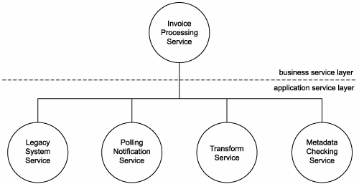
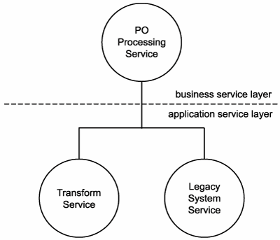
From service candidates to candidate service compositions

Slide 182
Common steps of modeling process

Slide 183
End of service-oriented analysis review

Slide 184
SOA delivery lifecycle

Slide 185
Service-oriented design
Service-oriented design is the process by which concrete physical service designs are derived from logical service candidates and then assembled into abstract compositions that implement a business process.

Slide 186
Analysis in this process
How can physical service interface definitions be derived from the service candidates modeled during the service-oriented analysis phase?
What SOA characteristics do we want to realize and support?
What industry standards and extensions will be required by our SOA to implement the planned service designs and SOA characteristics?

Slide 187
Objectives of service-oriented design
Determine the core set of architectural extensions.
Set the boundaries of the architecture.
Identify required design standards.
Define abstract service interface designs.
Identify potential service compositions.
Assess support for service-orientation principles.
Explore support for characteristics of contemporary SOA.

Slide 188
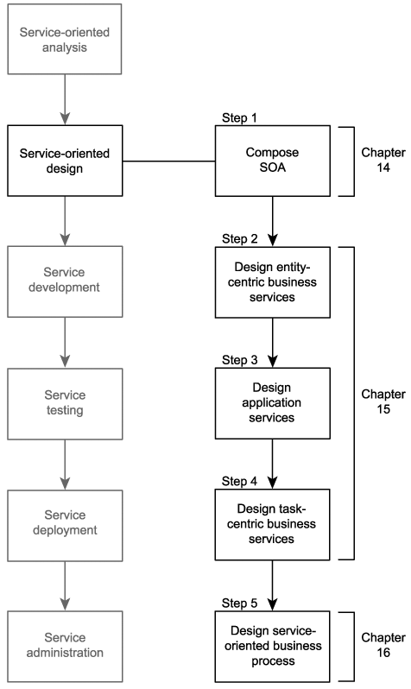

Slide 190
"WSDL first" Service Design
Before we can develop a service, we need to have defined the interface of that service - "WSDL first"
Defining the service interface prior to development is important to establishing a highly standardized service-oriented architecture and required to realize a number of the characteristics we identified as being part of contemporary SOA

